Slide 2
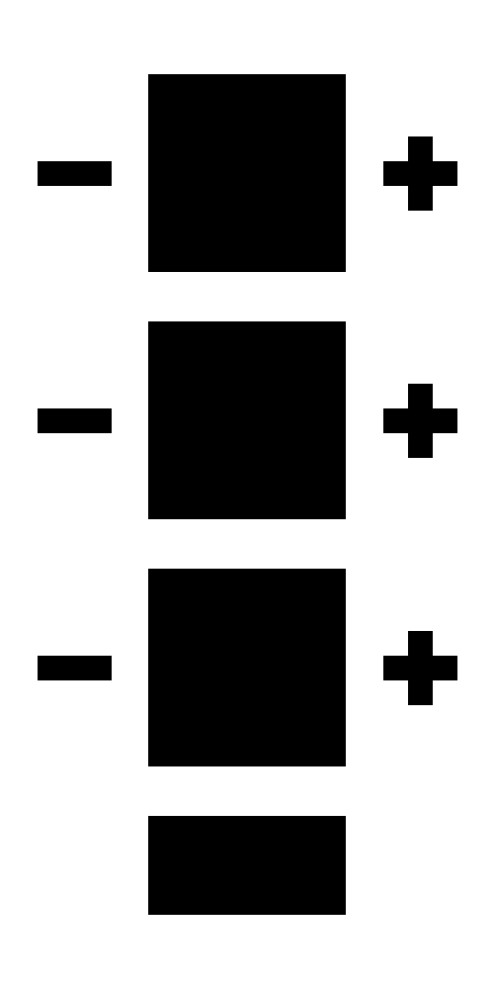

Slide 3
MIDI
10 cm
Switch
LED
LED
MIDI
3 cm
Switch
5 cm

